Slide 1



Project n Java
EXAMINATION
SYSTEM
PRESENTED TO
SPPU PROJECT EXAMINER
PRESENTED BY
Rishi & Rohit
16-12-2023

Slide 2

Agenda
1
Executive Summary
5
Frontend - Screenshots
2
Introduction
6
Databases
3
Objectives
7
Future Scope
4
UML Diagrams
8
Conclusion

Slide 3

Executive Summary
Examination also helps to ensure accurate and reliable tracking of results and statistics pertaining to student performance across various sessions.

Slide 4



Introduction
The Modern Examination System is a comprehensive software solution aimed at revolutionizing the way examinations are conducted and managed in educational institutions. This proposed system seeks to address the limitations of traditional examination processes by introducing a digital, user-friendly, and efficient platform for creating, administering, and evaluating exams.
Functionalities
. User Authentication and Management
Question Bank Management
Exam Taking
Administration

Slide 5

Objectives
SYSTEM OVERVIEW #1
USER MANAGEMENT #2
EXAM MANAGEMENT #3
Summarize the purpose and main functionalities of the examination system.
Describe how user accounts are managed, including creation, modification, and deletion.
Document how exams are created, edited, and managed within the system.
SCORING AND REPORTING #4
SCALABILITY #5
Document how the system scores exams and generates reports for administrators and candidates.
Scalability to accommodate growing organizations.

Slide 6
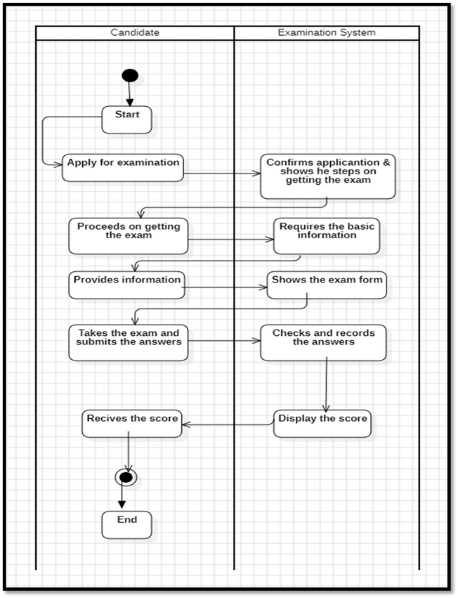
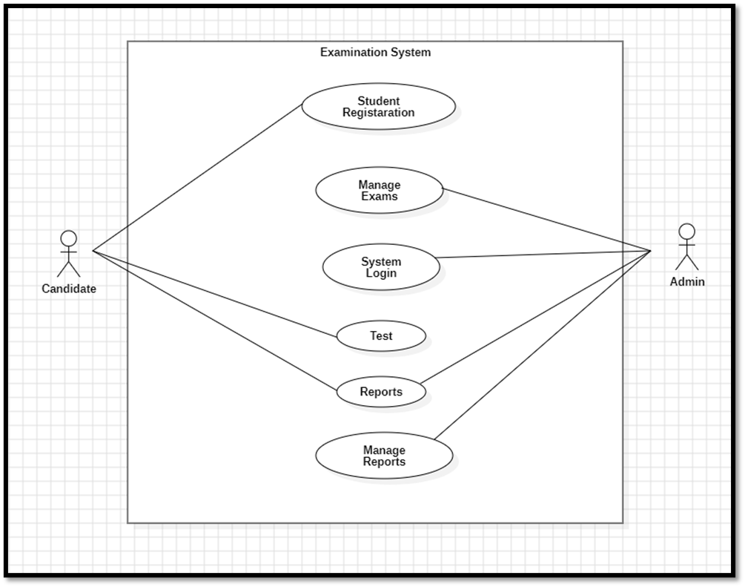
UML Diagrams
Use case Diagram
2. Activity Diagram

Slide 7
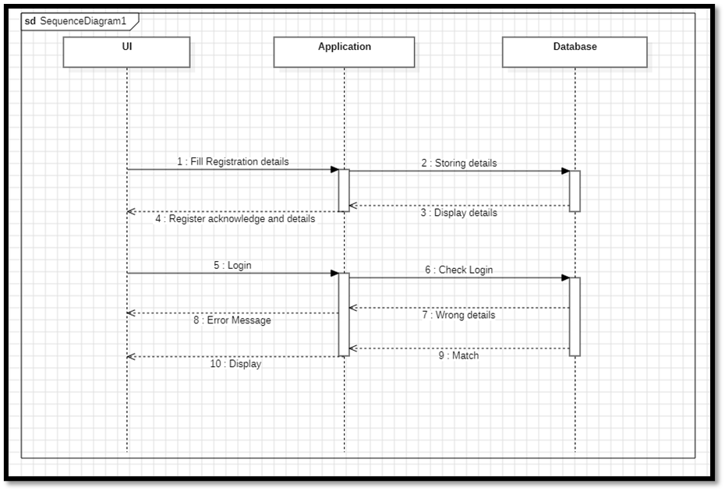
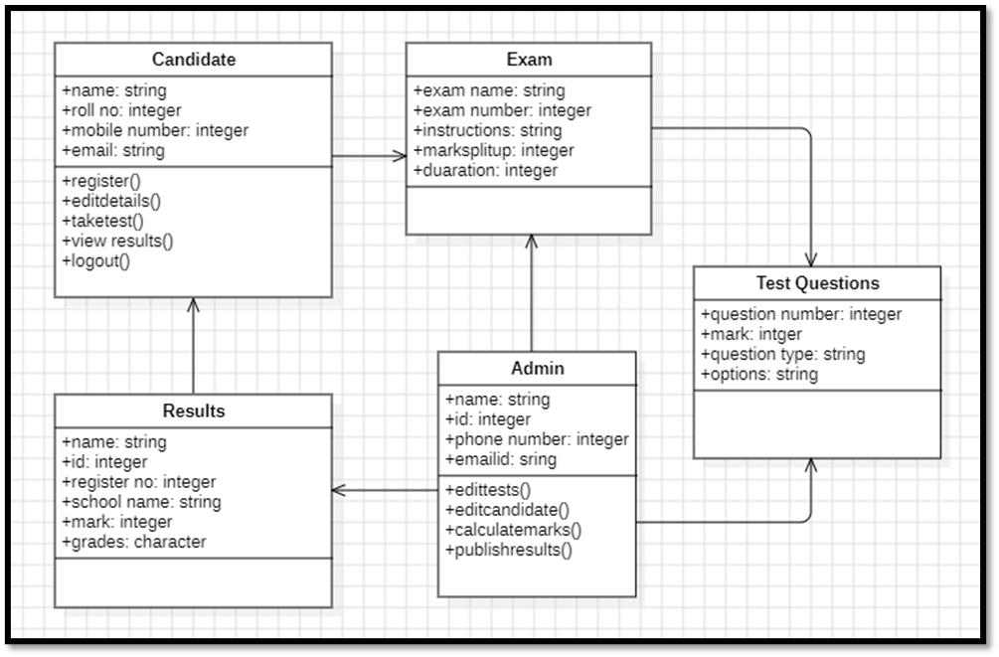
3. Sequence Diagram
4. Class Diagram

Slide 8
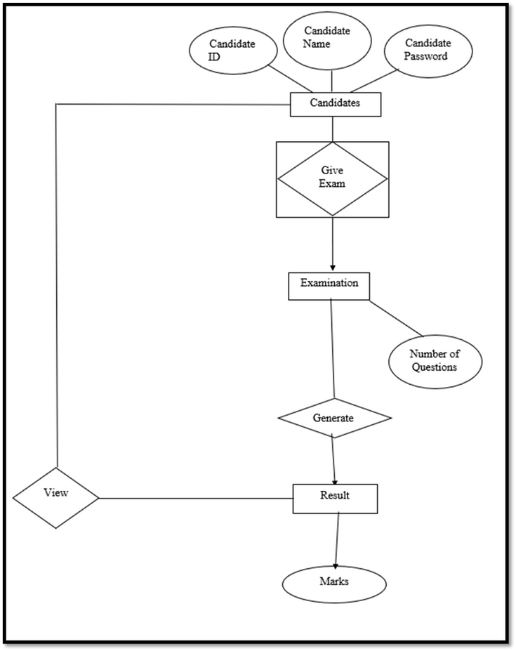
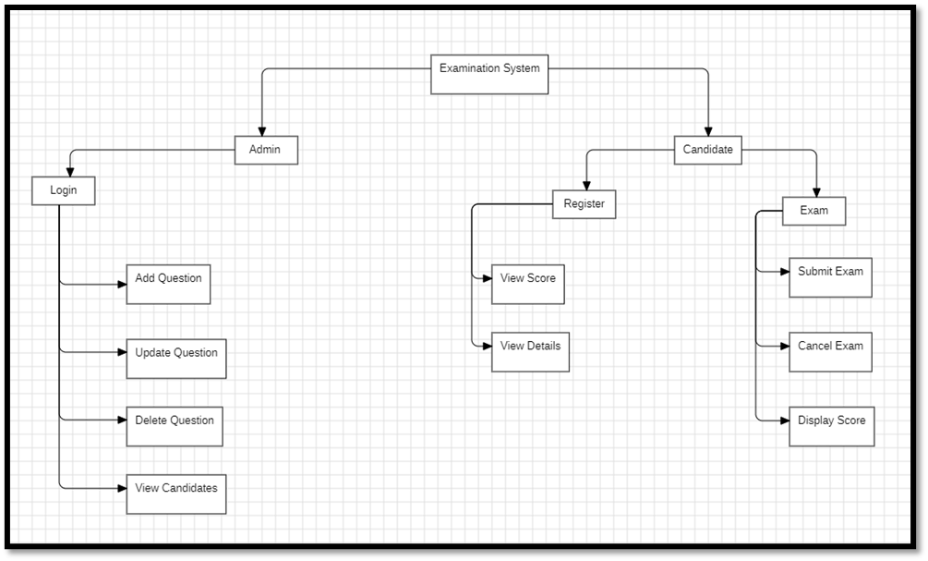
5. ER Diagram
6 Hierarchical Diagram

Slide 9
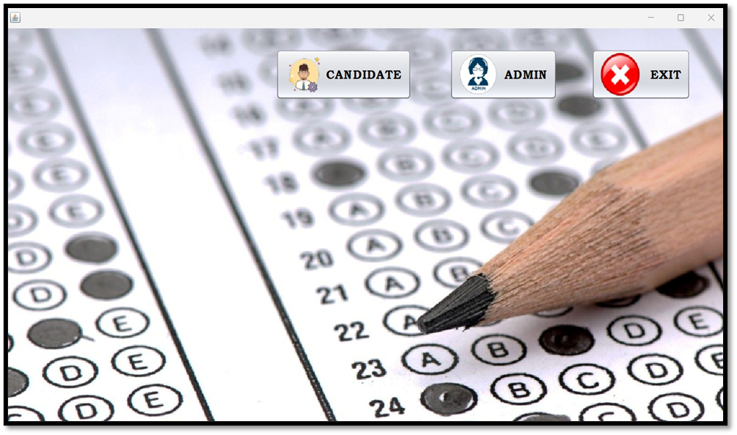

Frontend

Slide 10
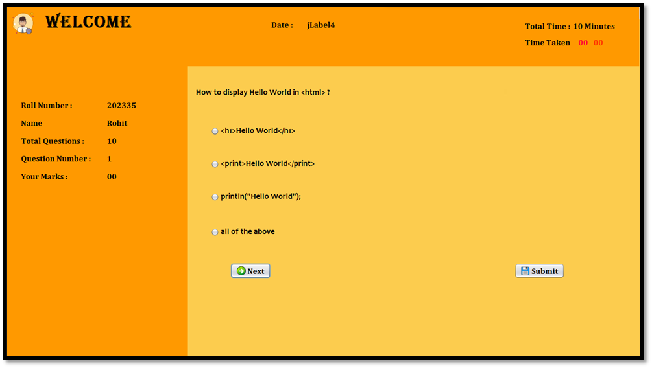

Slide 11
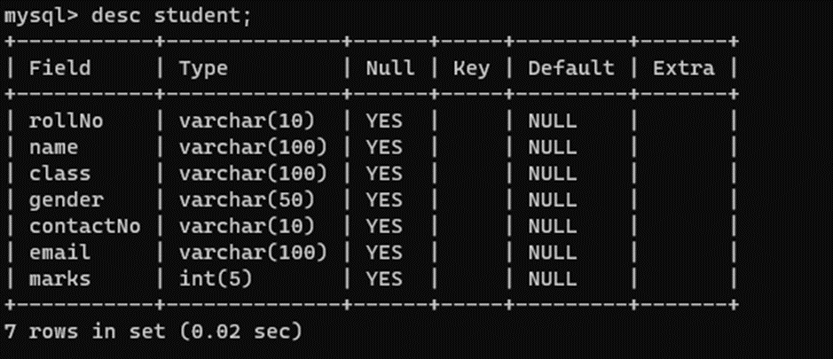
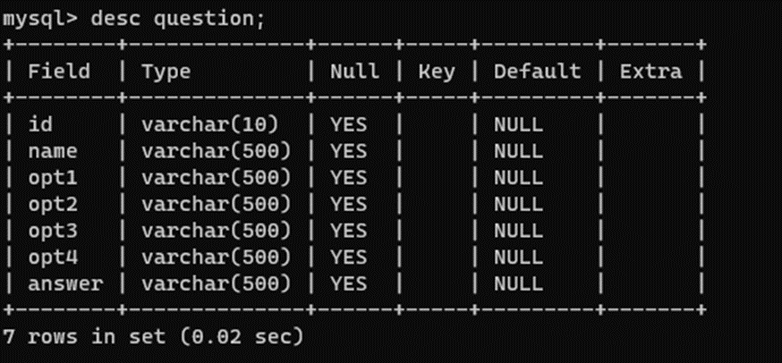
Database

Slide 12
Future Scope
Addition of new Courses
Search element for courses
Time limit exponent
Data reports
Organization and University applications

Slide 13
Conclusion
In conclusion, an effective examination system should strike a balance between assessing academic knowledge and promoting skills essential for success in real-world scenarios. Continuous refinement and adaptation to the evolving needs of education are crucial for ensuring that examination systems serve their intended purpose of fostering learning and development.
EMAIL
rishi.ram.20230201032
rohit.dhamale.20230201035

Slide 14
Thank
you!

